Slide 1
Micro-Credit Defaulter Model
Submitted by: Harneet Kaur Rehsi

Slide 2
ACKNOWLEDGMENT
I want to thank my SME Khusboo Garg and Flip Robo Techniques to express our sincere thanks to the following people, without whom we would not have been able to complete this project

Slide 3
INTRODUCTION
Business Problem Framing : A Microfinance Institution (MFI) is an organization that offers financial services to low income populations. The Microfinance services (MFS) provided by MFI are Group Loans, Agricultural Loans, Individual Business Loans and so on. They understand the importance of communication and how it affects a person’s life, thus, focusing on providing their services and products to low income families and poor customers that can help them in the need of hour
Review of Literature : In this project we need to build a machine learning model which can be used to predict in terms of a probability for each loan transaction, whether the customer will be paying back the loaned amount within 5 days of insurance of.
Motivation for the Problem Undertaken : The objective behind making this project understand the importance of communication and how it affects a person’s life, thus, focusing on providing their services and products to low-income families and poor customers that can help them in the need of the hour.

Slide 4
Analytical Problem Framing
Mathematical/ Analytical Modeling of the Problem : In this project, the dataset contains several rows and columns containing all the necessary information. For unwanted columns based on my analysis, I have drop them by using drop technique, also remove duplicate data present in the dataset and for outliers present In the dataset we have used several statistical methods and exploratory data visualization for better understanding and model building for predictions.

Slide 5
Data Preprocessing Done
Dataset contains some duplicate data so I have removed duplicate data and drop all the unwanted columns based on my analysis of the dataset. The dataset contains outliers in some of the columns so I have used describe method for understanding the data and distplot and boxplot for checking the skewness and outliers in the dataset then I have used Z_score method for removing the outliers from the dataset. As the numbers of columns are huge. For feature selection I have selected the best 10 columns on the basis of their score. Then I have used the 10 best features for further in the model,

Slide 6
Model/s Development and Evaluation
Identification of possible problem-solving approaches (methods) : The various analytical and statistical techniques used in the project are: describe for checking the health of the dataset and isnull().sum() for checking the null values if any are present in the dataset or not and shape for checking the numbers of rows and columns dataset contains. For outliers here I have used Z_score for removing the outliers from the columns in the dataset. And feature selecting technique SelectKBest , f_classif as the number of columns as huge so I have picked top 10 best features from all the features

Slide 7
Key Metrics for success in solving problem under consideration:
Z_score and Selecting features For outliers here I have used Z_score for removing the outliers from the columns in the dataset. And feature selecting technique SelectKBest , f_classif as the number of columns as huge so I have picked top 10 best features from all the features

Slide 8
Visualizations

Slide 9
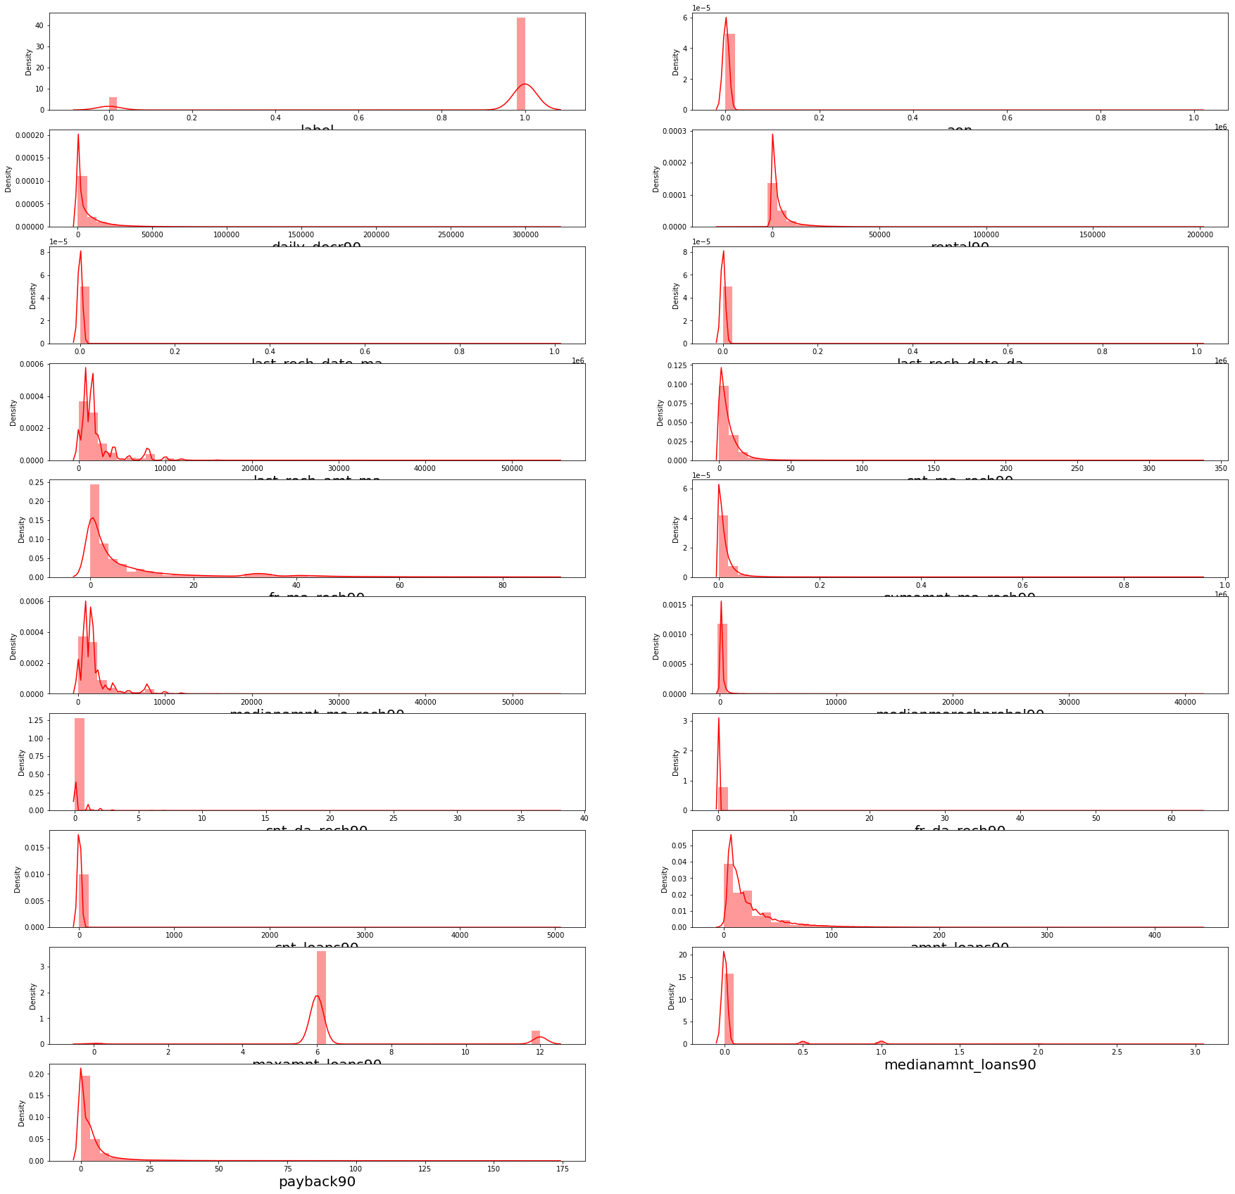
Here I have used distplot for checking the skewness in the data.

Slide 10
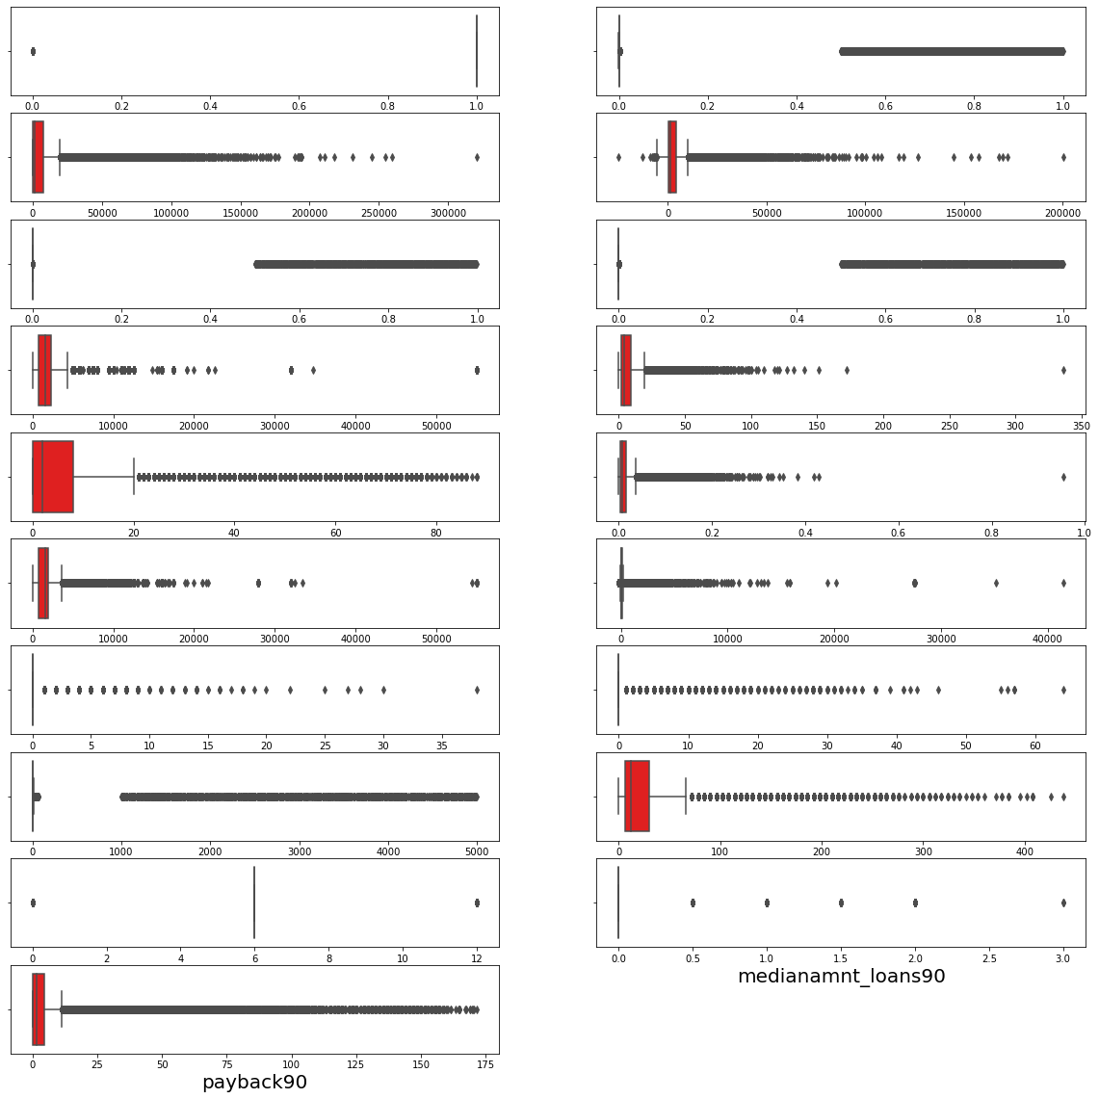
Here I have used boxplot for checking the outliers present in the data

Slide 11
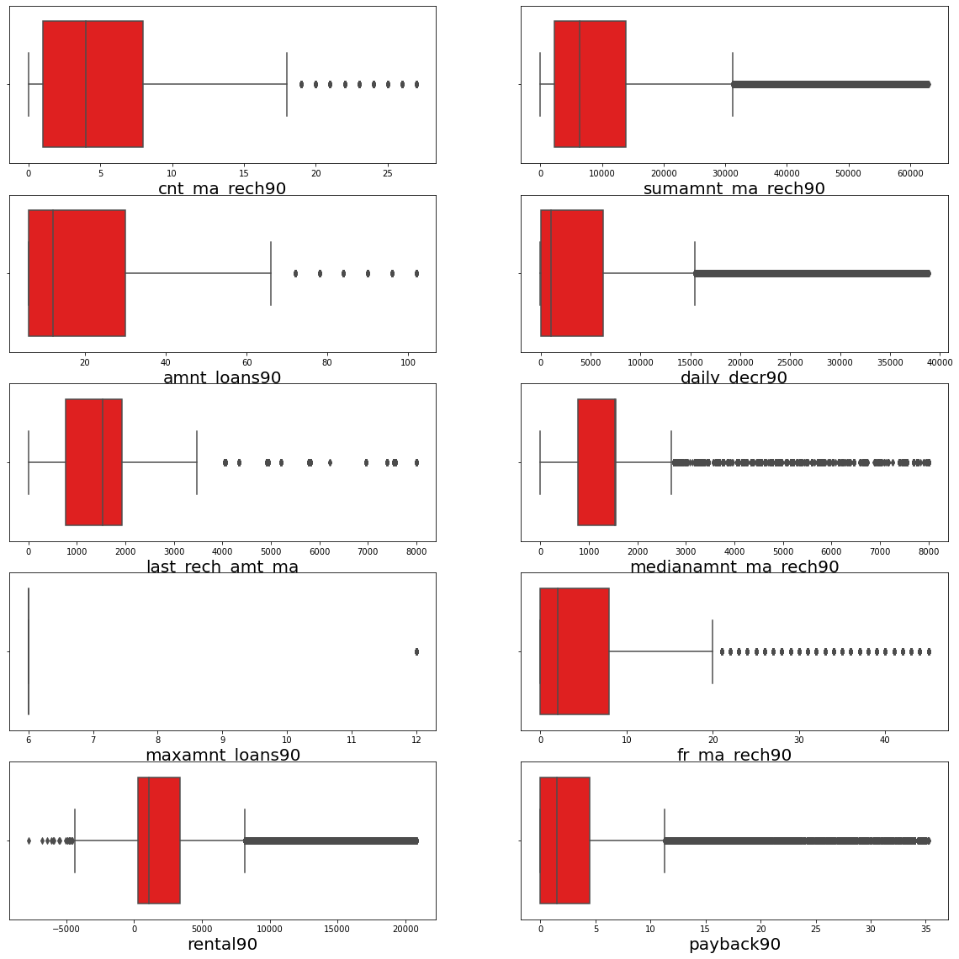
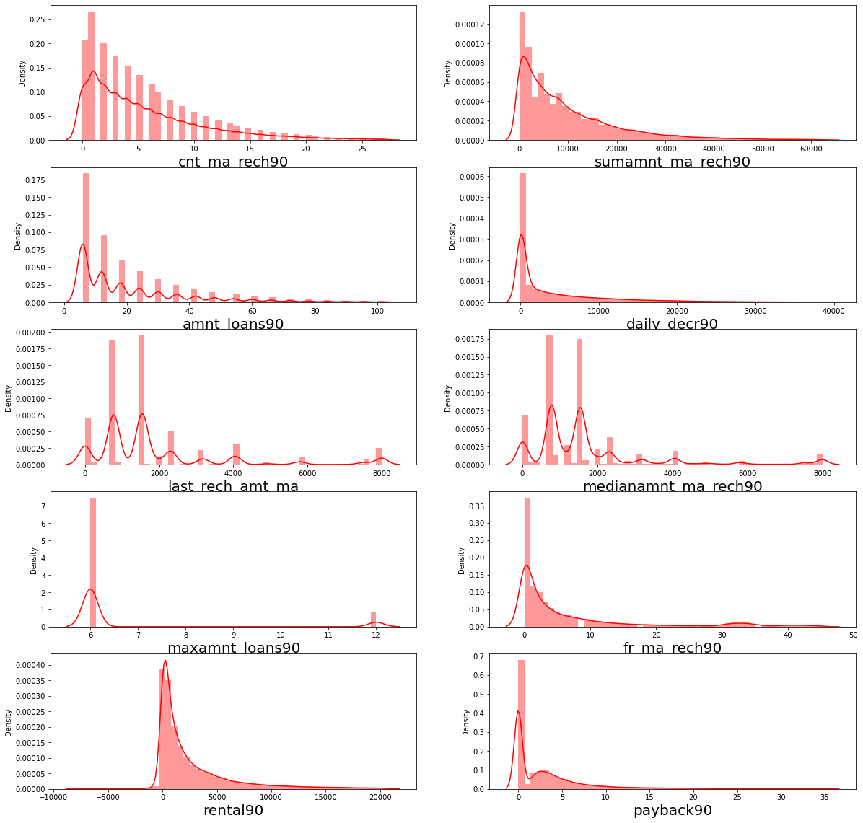
These graphs are after applying the techniques to remove shewness and outliers from the data of top 10 selected features

Slide 12
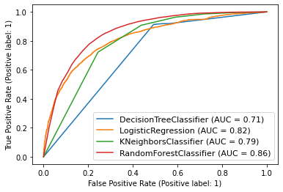
This curve contain the score of all the model I have used and these are the scores Random Forest Classifier model is fit best

Slide 13
Interpretation of the Results
After visualizing the graph the dataset contain skewness and outliers in the datset with the help of distplot and boxplot we can visualize them easily. And Random Forest Classifier model fits best for the model.

Slide 14
CONCLUSION
Key Findings and Conclusions of the Study:
After visualizing the data and graph the dataset contain skewness and outliers in the datset with the help of distplot and boxplot we can visualize them easily. And Random Forest Classifier model fits best for the model. The model that I have built “91” accuracy rate. I have tried different machine learning models the accuracy rate is the different in all the models. Random Forest Classifier gives the highest accuracy rate as compare to all other models.

Slide 15
Learning Outcomes of the Study in respect of Data Science: Data contains some duplicate values. To clean the data I used the drop. duplicate method and on basis of my analysis I have dropped several columns present in the particular dataset. . For removing outliers I have used z_score technique. For selection of top 10 best columns for the data used SelectKBest , f_classif as the dataset is huge so I have applied for the betterment of the result
Limitations of this work and Scope for Future Work: Random Forest Classifier model fits best for future prediction with an accuracy rate of 91% and AUC Score of 86%. so I analyzed that use a random forest classifier for better predictions

